Slide 1
Motor controller
Pre-internship Assignment
Chirag Kotian, 3rd year B.Tech Electrical Engineering, IIT Tirupati

Slide 2
Introduction
Dr. Mirjam Nilsson holds a Ph.D. in human biology from Glenwood University
20+ years of research in the field of cell mutation
Author of “Our Bodies, Our Cells” and several research papers on DNA
Trey Research board member

Slide 3
Overview
This study focused on learning whether natural or chemical causes are more likely to cause
cell mutation.
Causes of cell mutation
Effects of exposure
Funding for future research

Slide 4
Causes of cell mutation
NATURAL
CHEMICAL
Inherited: Joint mutation via natural selection
Acquired: Chromosomal mutation
Radiation exposure
Drug treatments
Industrial toxins

Slide 5
Effects of radiation exposure

Slide 6
Effects of chemical exposure

Slide 7
Impact on cell components
RNA
Mitochondria
Cell mutation caused by different chemicals affects each part of the cell differently. Here is the percentage of change to each cell type, broken out per chemical.

Slide 8
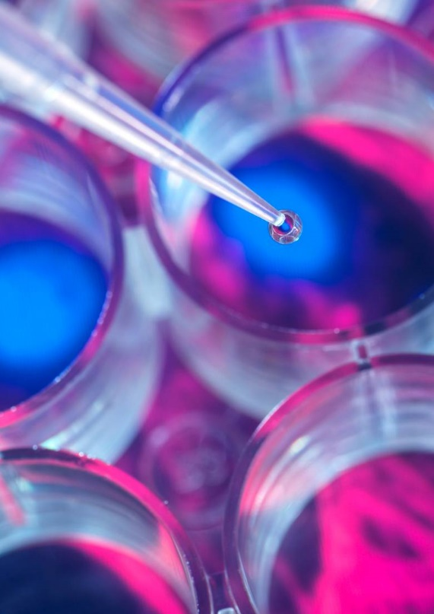
Funding for forthcoming research
 | Government | Private
Cell mutations | 5,000 | 40,000
Gene therapy | 50,000 | 400,000
Drug therapy | 500,000 | 4,000,000
TOTAL | 555,000 | 4,440,000

Slide 9
Thank you
Mirjam Nilsson​
206-555-0146
mirjam@contoso.com
www.contoso.com

